Slide 1
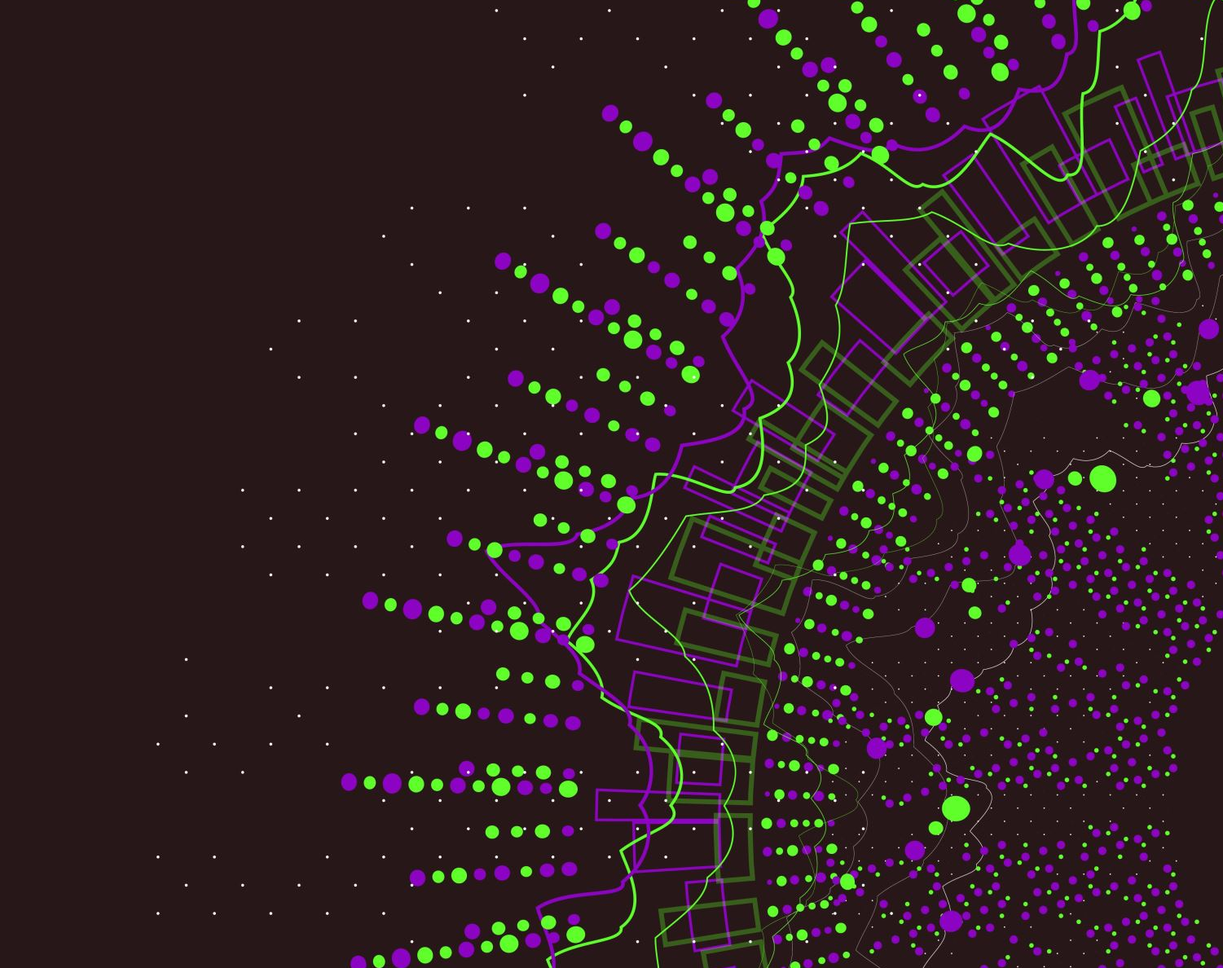
Digital System for Botany Slides
Dr: Diaa Naser

Slide 2

Students names
1- Rehab Hamdy
2- Hagar AbdElaliem
3- Mahmoud Waheed

Slide 3
- 6 Phases of the Software Development Life Cycle
ANALYSIS
DESIGNE
DEVELOPMENT
TESTING
DEPLOYMENT
MAINTENANCE
Product Agent
Project Manager
Business Analyst
System Architect
UX/UI designer
Front-end Developer
Back-end Developer
Solutions Architect
QA Engineer
Tester
Data Administrative
Users Architect
Testers
Support Managers

Slide 4
1-Phase: ANALYSIS
Problem Definition
There are manual operations in the Botany department
Students need to borrow slides
Doctors need some slides
The department head inquires about the slides !
Peoples && Problems
Students
Doctors
Admin

Slide 5
2-Phase: DSIGNE
2.1 System Architect :
Solution Description (Methods) :
DB
Admin
Login
User
Login
Input
Processing
Admin Process
Result

Slide 6


2-Phase: DSIGNE
2.1 System Architect :
UML Use Case Diagram :
Login
Create new user
Login
Manage User
Delete user
Select
User Info
Update existing user
Request
Export To
Reports
Forms
Search
PDF
Excel

Slide 7
2-Phase: DSIGNE
Tools :
MySQL Workbench -V 8.0 CE
Android Studio -V 2021.2.1
Figma website Online
Online Color picker Online
Logo Designer Online
Rive For animations Online
Trello Online
Technologies:
Dart --Version 2.18.5
Flutter --Version 3.3.9
Firebase Authentication
Firebase Cloud Messaging
GitHup
MVVM
Provider

Slide 8
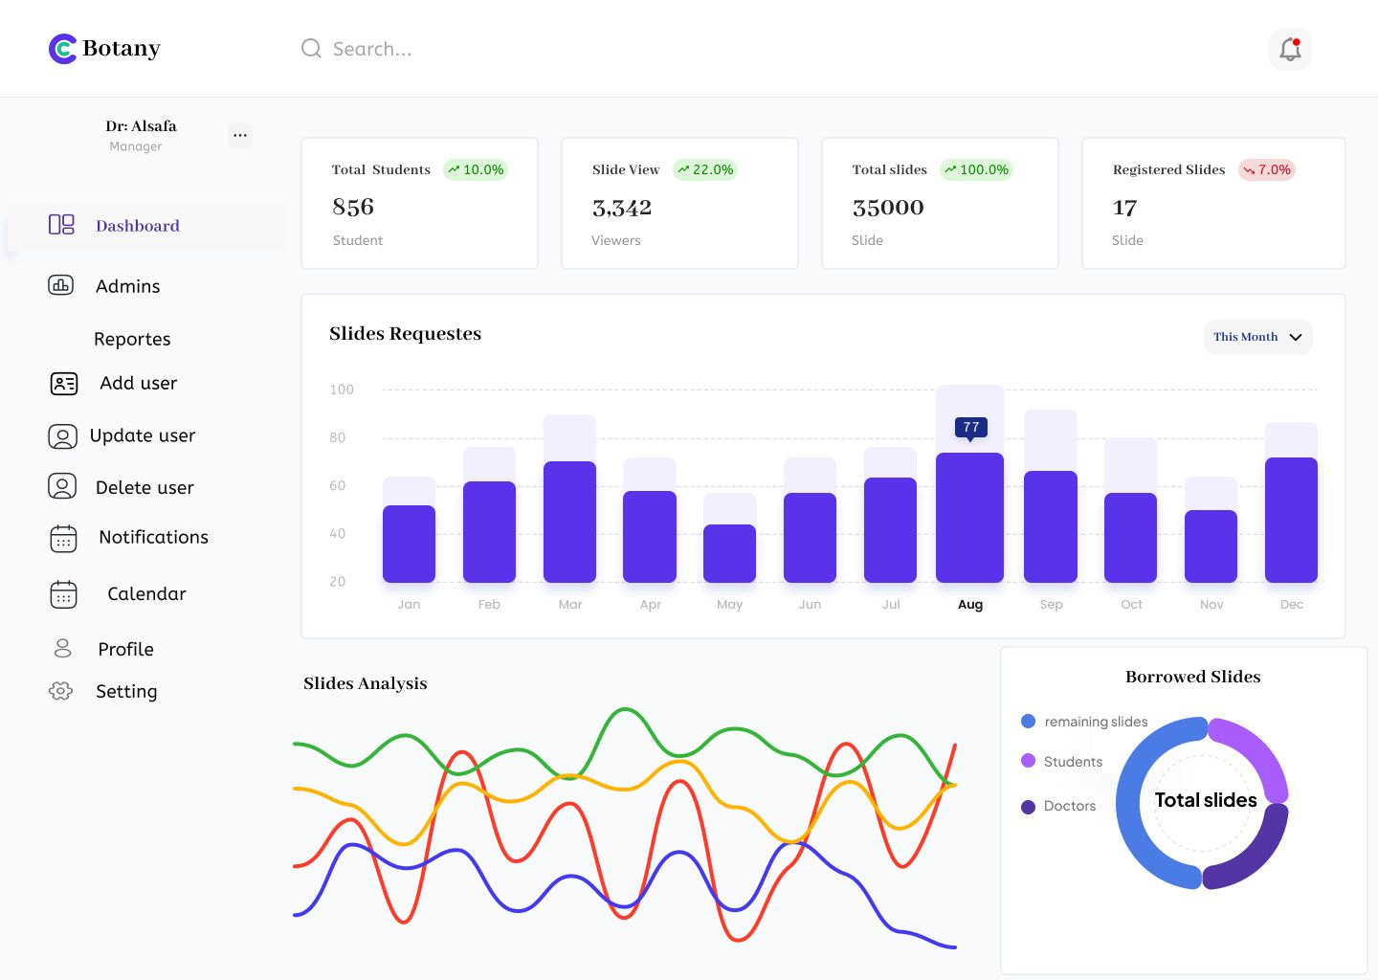
2-Phase: DSIGNE
2.2 UX/UI Designer :
Dashboard :

Slide 9
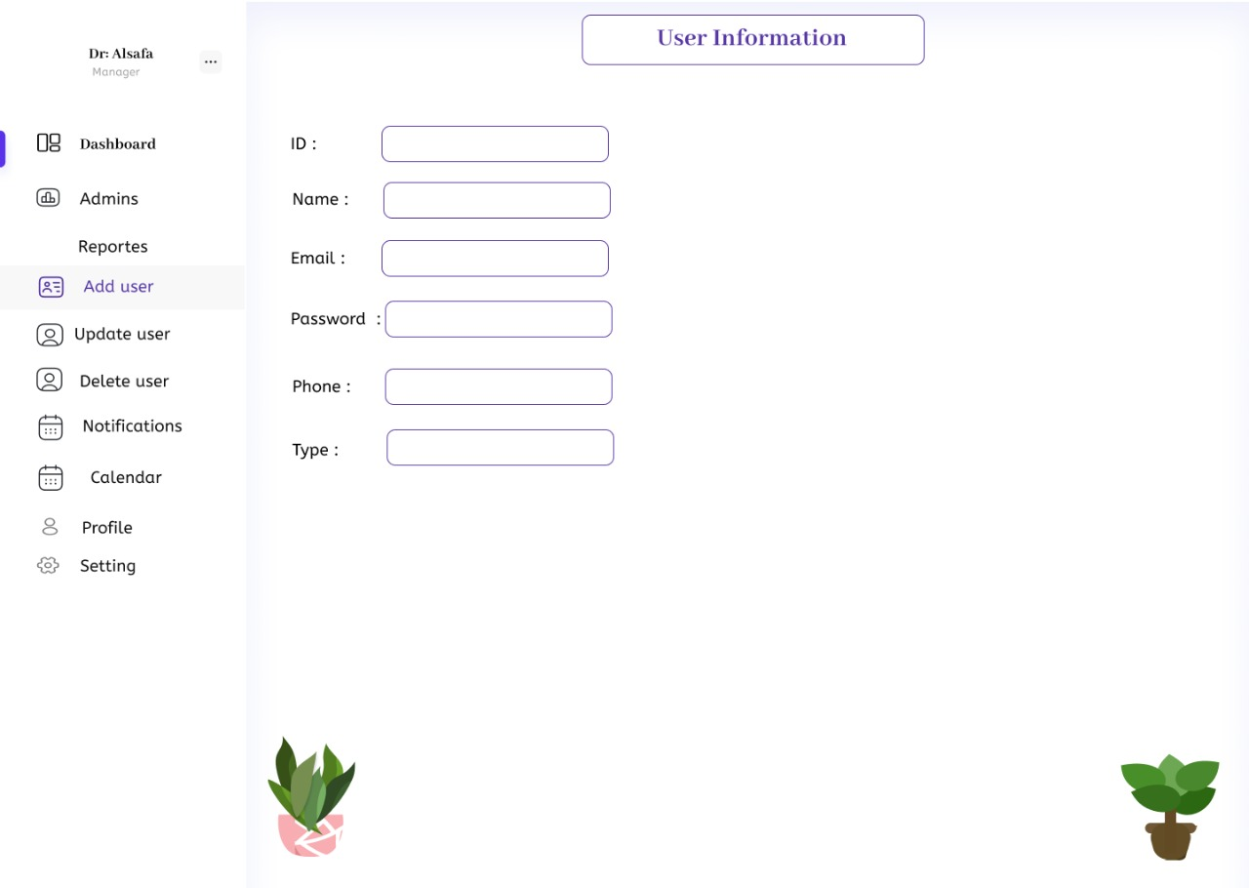
2-Phase: DSIGNE
2.2 UX/UI Designer :
Add User :

Slide 10
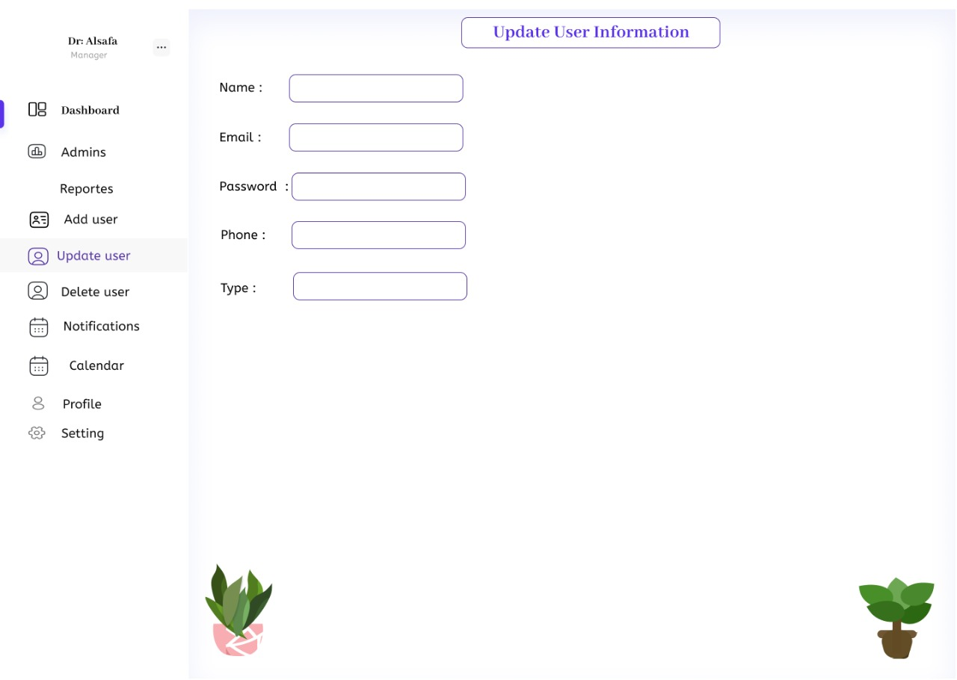
2-Phase: DSIGNE
2.2 UX/UI Designer :
update User :

Slide 11
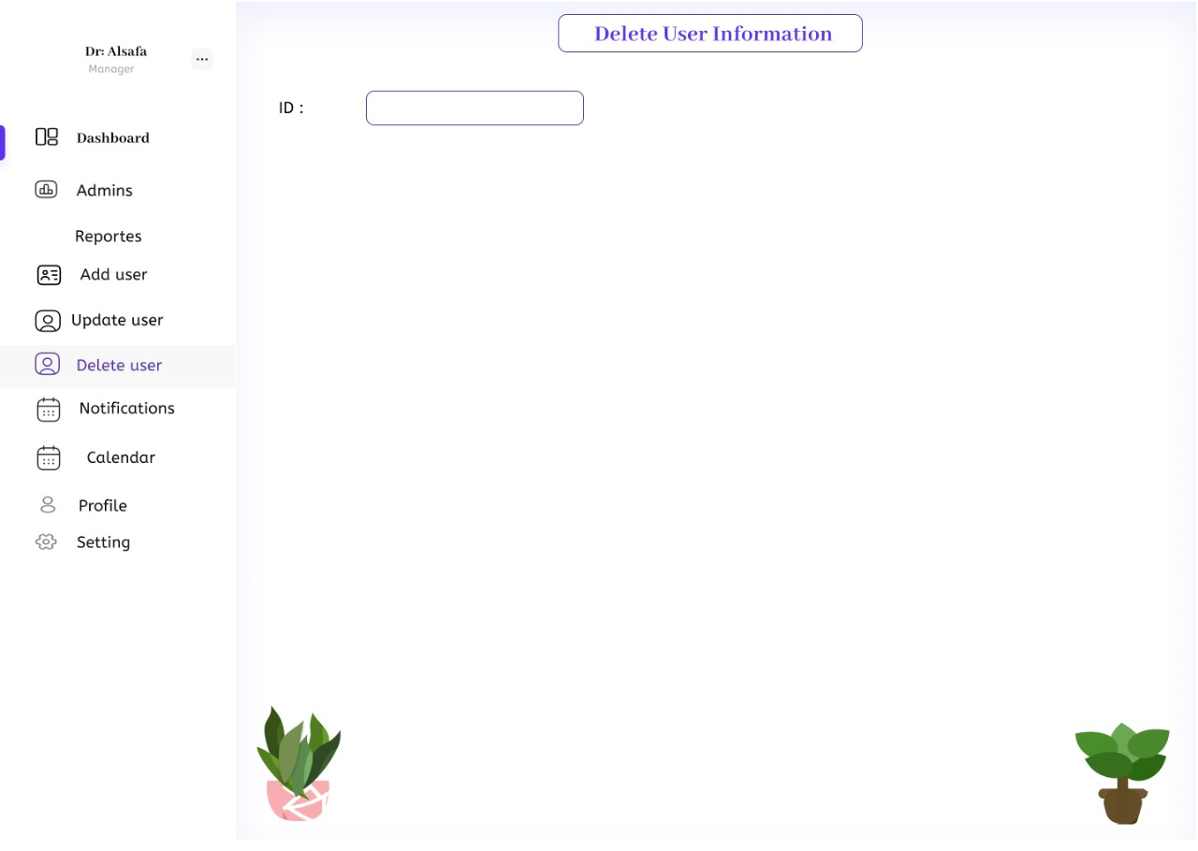
2-Phase: DSIGNE
2.2 UX/UI Designer :
Delete User :

Slide 12
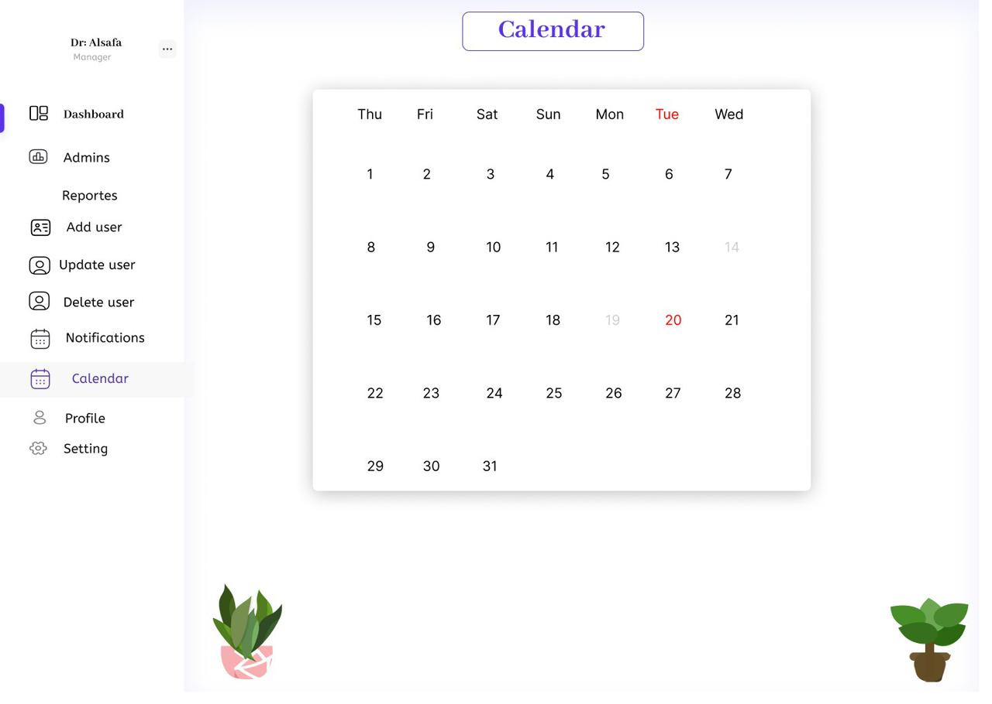
2-Phase: DSIGNE
2.2 UX/UI Designer :
Calendar:

Slide 13

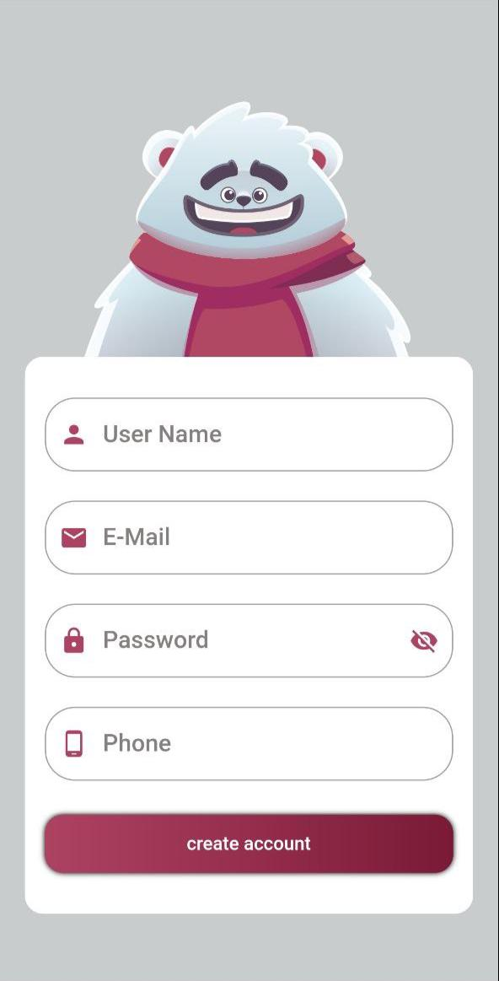
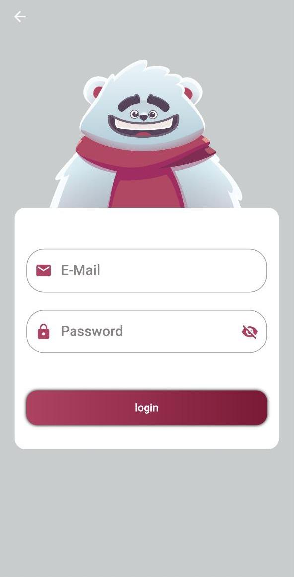
2-Phase: DSIGNE
2.2 UX/UI Designer :
Splash Screen :
Register Screen :
Login Screen :

Slide 14
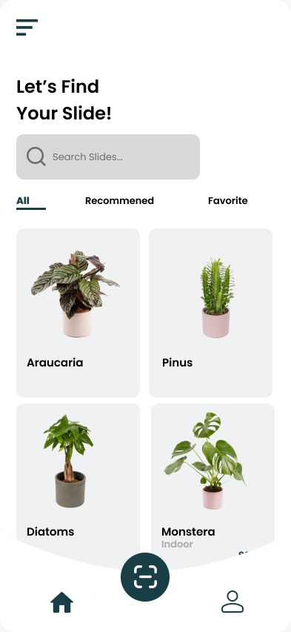
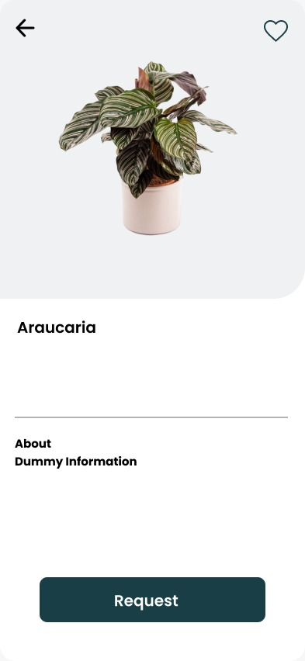
2-Phase: DSIGNE
2.2 UX/UI Designer :
User Screen:
Request Screen :

Slide 15
3-Phase: DEVELOPMENT
3.1 Back-end Developer :
ER Diagram
Relational Model
Connection with firebase
Tables Models on Firebase
MVVM
Sign up Authentication
Login Authentication
Notifications

Slide 16
1-The ER Diagram
ID
Image
Ceils
ArabicName
EnDate
Notes
Course
Supervisor
StDate
ReDate
EngName
Count
SlideNo
Position
Slide
BoxNo
N
Borrow
M
CupBord
FNum
Name
Password
d
Level
State
UserId
Phone
Specimen
SpecialGroup
Others
Person
Email
Type
SectionType
LatineName
Family

Slide 17
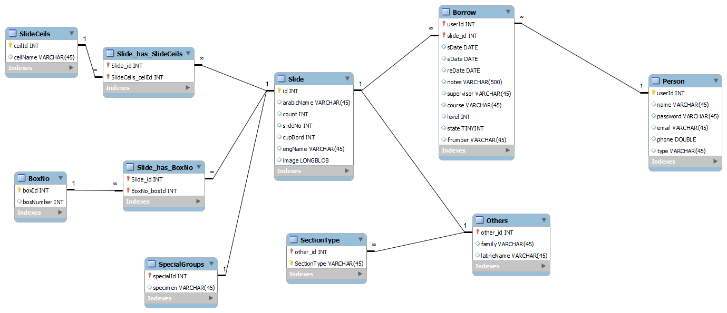
3-Phase: DEVELOPMENT
3.1 Back-end Developer :
Relational Model :

Slide 18
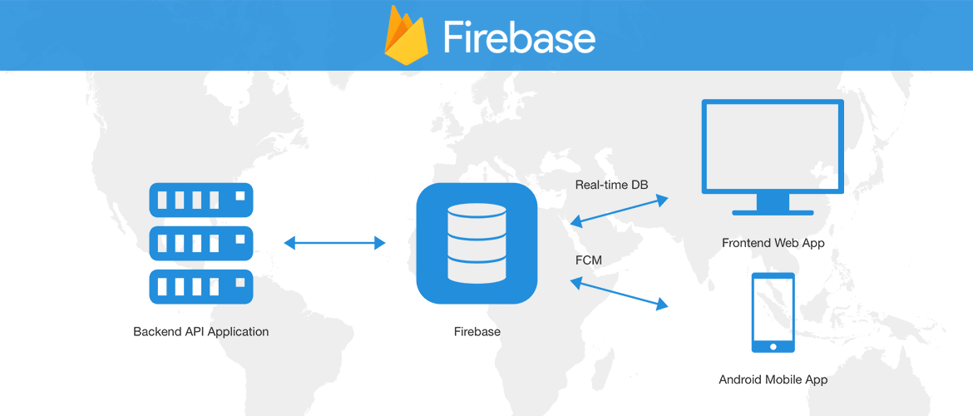
3-Phase: DEVELOPMENT
3.1 Back-end Developer :
Connection With firebase:

Slide 19
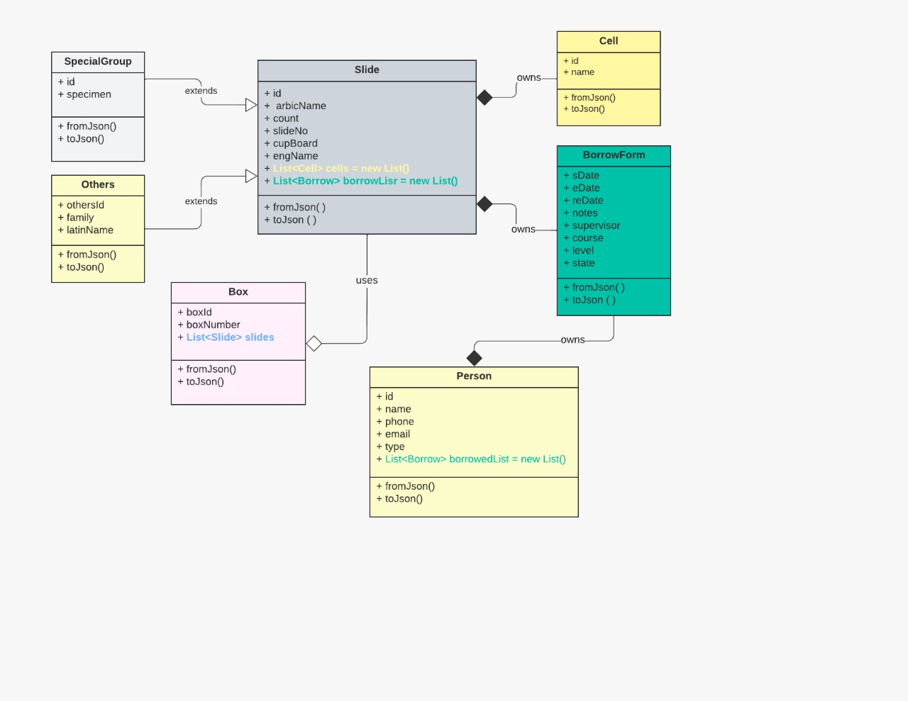
3-Phase: DEVELOPMENT
3.1 Back-end Developer :
UML Model For Tables :

Slide 20
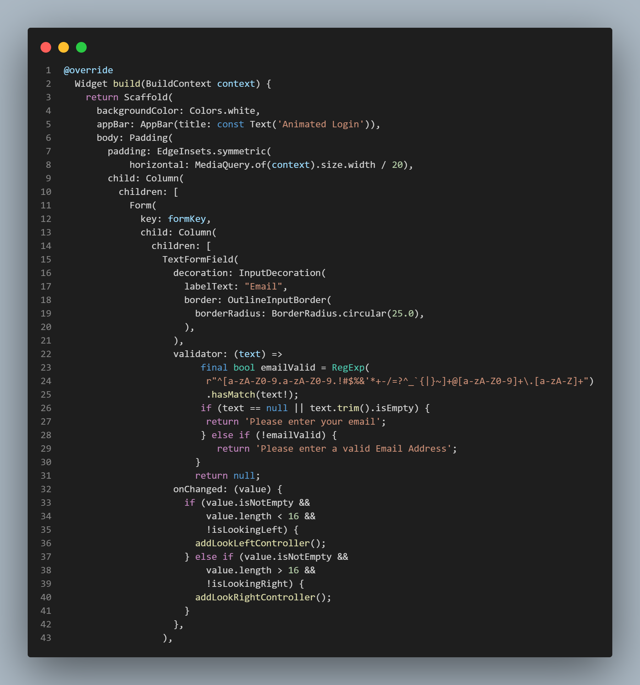
3-Phase: DEVELOPMENT
3.1 Back-end Developer :
MVVM :

Slide 21
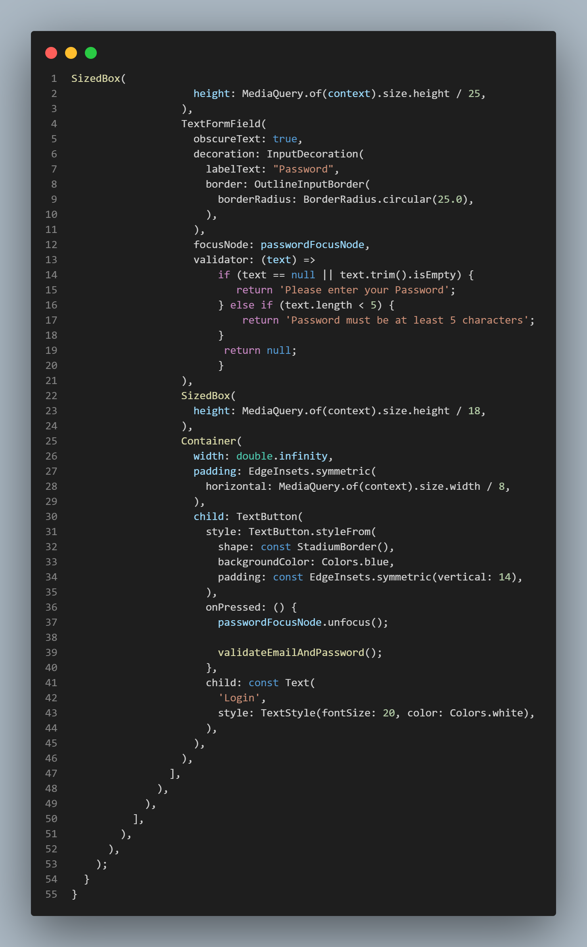
3-Phase: DEVELOPMENT
3.1 Back-end Developer :
MVVM :

Slide 22
3-Phase: DEVELOPMENT
3.1 Back-end Developer :
MVVM :
Values
Get
View
View Model
Model
Events
Save
UI
Business Logic
Data

Slide 23
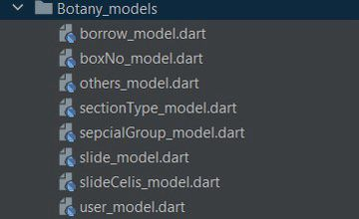
3-Phase: DEVELOPMENT
3.1 Back-end Developer :
Tables Models on Firebase :

Slide 24


3-Phase: DEVELOPMENT
3.1 Back-end Developer :
Login Authentication :
on validation failed bear.addFailController()
Login
click
Void login()
Validation Succeeded
viewModel.signInWithEmailAndPassword(email, password)
On Succeeded
Tray to authenticate user from firebase
DB
on FirebaseAuthException catch error
Print Error Message !

Slide 25
3-Phase: DEVELOPMENT
3.1 Back-end Developer :
Sign up Authentication :
on validation failed bear.addFailController()
Login
click
Void login()
Validation Succeeded
viewModel.createUser(email, password)
On Succeeded
Tray to authenticate user from firebase
DB
on FirebaseAuthException catch error
Print Error Message !

Slide 26


